Slide 1
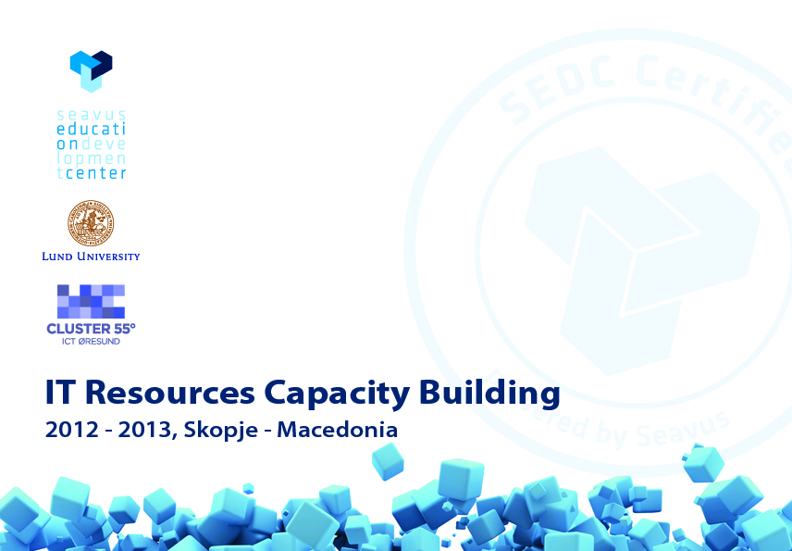
Stored Routines 4 June – 30 June 2012

Slide 2

Stored Routines
An SR is a subroutine available to applications accessing a relational database management system (RDBMS).
An SR is a program code (like in a regular computing language) stored in the database (DB) server.
An SR is saved in the SQL server and perhaps compiled when the source code is saved.

Slide 3
Stored Routines
An SR could be simply seen as a set of SQL statements. Its body is a list of SQL statements.
An SR has a name, may have a parameter list, and may contain a set of SQL statements.
An SR is created using the CREATE command.

Slide 4
Stored Routines
Most of the RDBMS are supporting three types of routines:
Stored Procedures (SP),
Stored Functions (SF),
Triggers.

Slide 5
Stored Routines
An Stored Procedure (SP) is a stored program that is called by using an explicit command (CALL). It does not return an explicit value.
An Stored Function (SF) is a stored program that could be used as a user defined function and it is called by using just its name (without an explicit command). It can return a value that could be used in other SQL statements the same way it is possible to use pre-installed MySQL functions like pi(), replace(), etc.

Slide 6
Stored Routines
A Trigger is a stored unit of code that is attached to a table within the database. It is automatically created using the CREATE command. It is activated and called when a particular event (INSERT, UPDATE, REPLACE, DELETE) occurs for the table.

Slide 7
Stored Routines
Parameter Types:
IN. This is the default (if not specified). It is passed to the routine and can be changed inside the routine, but remains unchanged outside.
OUT. No value is supplied to the routine (it is assumed to be NULL), but it can be modified inside the routine, and it is available outside the routine.
INOUT. The characteristics of both IN and OUT parameters. A value can be passed to the routine, modified there as well as passed back again.

Slide 8
Stored Routines
Stored Routines Advantages
SRs are executed far more often that they are written.
SRs help concentrating the business logic of the DB only in one place. They help separating the business logic of the application from the underlying data model.
SRs help reducing communication and network traffic for data intensive applications.
SRs are portable and there is no need to re-create the logic in all the clients.

Slide 9
Stored Routines
SRs could be used to reduce complex SQL statements. Complex SQL statements (joins and correlated queries) are very hard to optimize. Using a procedural approach (breaking down the complex SQL statements) it is possible to specify the desiderate specs for processing, reducing and gluing the statements.
SRs ensure a consistent and secure environment, where applications and users do not need to have access to the database tables directly, but can only execute specific stored routines.
SRs can help securing an environment resistant to SQL injections.
SPs (no SFs or Triggers) can help with parse overhead (similar to prepared statements, dynamic SQL).

Slide 10
Stored Routines
SPL is not optimized for number crunching, for complex mathematical operations. Complex mathematical operations or compute intensive operations are better to implemented in other programming languages (C, C++, PHP, etc.).
SQL is highly optimized for SET operations within groups of data, while reading data row by row may not always be as effective as reading groups, chunks of data.

Slide 11
Stored Routines
Debugging SRs in environment with complex business logic is not trivial.
Portability across Stored Program Languages is not trivial.
SRs lack a couple of ANSI standard features: the ability to SIGNAL user own exceptions, the possibility with a single handler to manage all the possible exceptions.
SR Recursion.
It is not possible to use Dynamic SQL inside SFs or Triggers.
The following statements are not allowed in SRs: CHECK TABLE, LOCK TABLES, UNLOCK TABLES, LOAD DATA.

Slide 12
Stored Routines
Demo:
- StoredProcedures.sql
- Functions.sql
- Triggers.sql

Slide 13


